Slide 1
What ?
Why ?
How ?
Where ?
MACHINE LEARNING
Presented By :
Dasari Mohan Krishna

Slide 2
What is Machine Learning?
ML is a branch of artificial intelligence:
The ability of a machine to do prediction of future data based on historical data that it had learnt from
Extracting patterns, fitting data to functions, classifying data, etc
ML systems can learn and improve
With historical data, time and experience
Bridges theoretical computer science and real noise data.

Slide 3
Why Machine Learning?
According to a recent study, machine learning algorithms are expected to replace 32% of the jobs across the world, in the next 10 years.
With the rapid growth of big data and availability of programming tools like Python and R – machine learning is gaining mainstream presence for data scientists.
Machine learning applications are highly automated and self-modifying which continue to improve over time with minimal human intervention as they learn with more data.

Slide 4
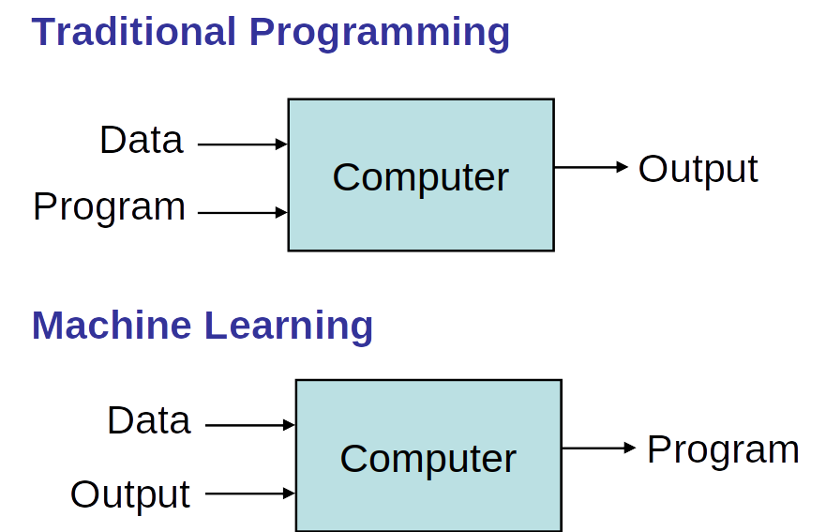
HOW ?

Slide 5
Where ?
Internet search engines,
Email filters to sort out spam,
Websites to make personalised recommendations (Netflix, Amazon, All ecommerce websites)
Banking software to detect unusual transactions
Our phones such as voice recognition, auto correction.
Medical and Drug Research
Automobile Industry
Governance and defense systems
The applications are endless…

Slide 6
Types of Machine Learning Algorithm
Machine Learning algorithms are classified as –
Supervised Machine Learning Algorithms
Unsupervised Machine Learning Algorithms
Reinforcement Machine Learning Algorithms

Slide 7
Supervised Machine Learning Algorithms
Machine learning algorithms that make predictions on given set of samples. Supervised machine learning algorithm searches for patterns within the value labels assigned to data points.
For every example in the data there is always a predefined outcome
Models the relations between a set of descriptive features and a target (Fits data to a function)
2 groups of problems:
Classification : Predicts which class a given sample of data (sample of descriptive features) is part of (discrete value).
Regression : Predicts continuous values.

Slide 8
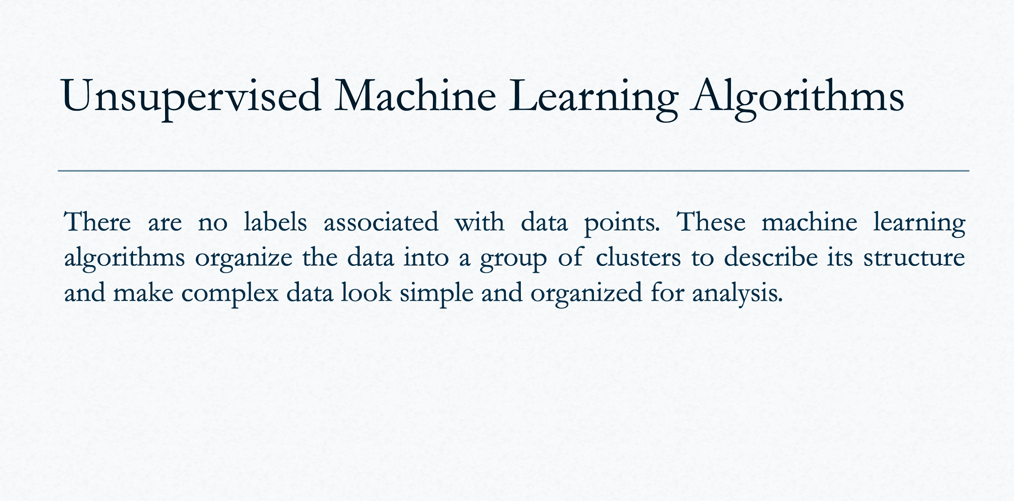
Clustering
Dimensionality reduction

Slide 9
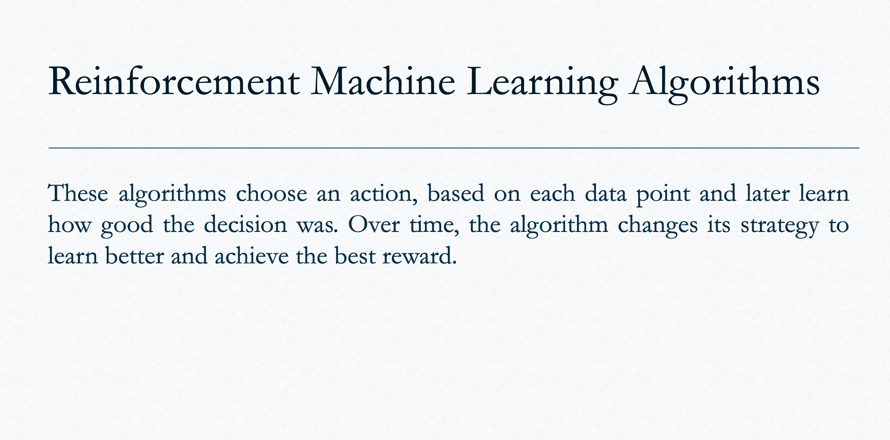

Slide 10
Machine Learning as a Process
- Define measurable and quantifiable goals
- Use this stage to learn about the problem
Define Objectives
- Normalization
- Transformation
- Missing Values
- Outliers
Model Deployment
Data Preparation
Study models accuracy
- Work better than the naïve
approach or previous system
Do the results make sense in the context of the problem
- Data Splitting
Features Engineering
Estimating Performance
Evaluation and Model Selection
Model Evaluation
Model Building

Slide 11
ML as a Process:
Data Collection
Data Preprocessing
Model Building
Model Training
Model Evaluation
Model Deployment

Slide 12
Popular Machine Learning Algorithms
Linear Regression
Logistic Regression
Decision Tree
Random Forest
Support Vector Machine
K-Nearest Neighbors
Neural Networks

Slide 13
Machine Learning Fields
Natural Language Processing (NLP)
The main objective of NLP is to enable computers to understand, interpret, and generate human language using machine learning algorithms and computational linguistics techniques.
Computer Vision
The ultimate goal of computer vision is to create machines that can "see" and interpret the world in the same way as humans. It has applications in a wide range of fields, such as autonomous vehicles, surveillance, robotics, medical imaging, and augmented reality.
Time Series Analysis
Time Series Analysis is a statistical technique used to analyze and interpret data that is measured over time. It involves studying patterns and trends in the data to identify relationships and make predictions about future values.

Slide 14
Conclusion
In conclusion, machine learning is a powerful technology that enables computers to learn and improve from experience without being explicitly programmed. It has applications in a wide range of fields, such as healthcare, finance, manufacturing, and more.
The three main types of machine learning are supervised learning, unsupervised learning, and reinforcement learning. Additionally, there are several subfields of machine learning, such as natural language processing, computer vision, and time series analysis, each with its own unique set of techniques and applications.
With the advancement of technology and the availability of large amounts of data, machine learning has the potential to transform the way we live, work, and interact with the world around us.

Slide 15
Further Readings
Towards Data Science - a popular online publication that covers a wide range of data science topics, including machine learning. You can find articles and tutorials on different machine learning algorithms and techniques.
Machine Learning Mastery - a website dedicated to helping beginners and advanced learners understand and implement machine learning. The site offers tutorials, books, and courses on various topics related to machine learning.
Google AI Blog - Google's official blog for AI research and developments. It features posts on the latest advances in machine learning, including research papers, technical reports, and case studies.
Stanford CS229 - the course website for Stanford's CS229: Machine Learning course. It offers lecture notes, assignments, and projects on various topics related to machine learning.

Slide 16
Thank You

